Slide 1
The Grey Zone in Adjuvant/ Neoadjuvant Therapy in Early Breast Cancer
Heba El Zawahry M. D.
Prof. Medical Oncology
NCI, Cairo University

Slide 2


Why Grey = inconvenient decision
Why inconvenient
A balance between previously established guidelines and new data related to biomarker /biological subtypes
Why this happened in Adjuvant /neoadjuvant
HER2-+ve anti-HER2 therapy plus chemotherapy
TNBC chemotherapy alone
IN hormone positive, HER2 negative subgroup of cancers that the biggest confusion lies.
??? Many patients do well with endocrine therapy alone and thus, the addition of chemo could represent an overtreatment.

Slide 3
predicted sensitivity to particular treatment methods and benefit from their use.
TNM , Menopausal, biomarker
Final decision should be build on
BIOLOGY OF BREAST CANCER patient’s biological age comorbidities and
PS
The decision on systemic adjuvant treatment should be based on:
EBC;ESMO guidelines; Annals of Oncology24,supplement 6,2013

Slide 4
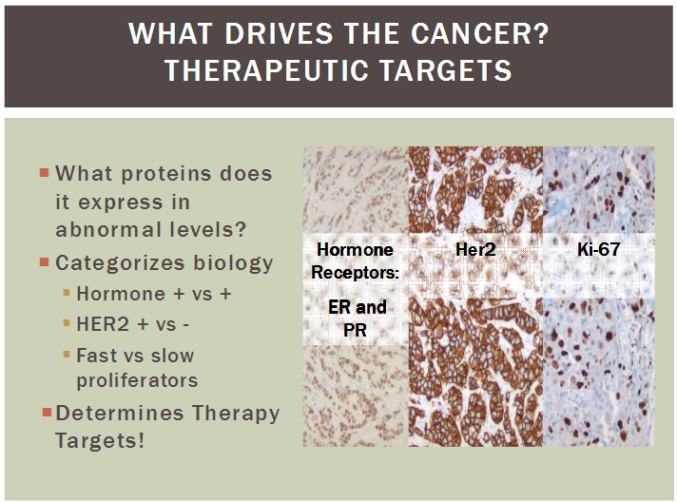
-ve

Slide 5
Biological (intrinsic ) subtypes of breast cancer
Luminal A
‘Luminal A-like’
• ER-positive
• HER2-negative
• Ki67 low*
• PgR high**
Luminal B
‘Luminal B-like (HER2-negative)’
• ER-positive
• HER2-negative
and either
• Ki67 high or
• PgR low
‘Luminal B-like (HER2-positive)’
• ER-positive
• HER2-positive
• any Ki67
• any PgR
HER2 overexpression
‘HER2-positive (nonluminal)’
• HER2-positive
• ER and PgR absent
‘Basal-like’
‘Triple-negative (ductal)’
• ER and PgR absent
• HER2-negative

Slide 6
Possible Surrogate Markers for Hormone Resistance
LUM A LUM B HER 2Neu
ER
PR
HER2
RS
Low Ki-67 High Ki-67
Hormonal therapy Hormonal / chemo Chemo/Anti HER

Slide 7


Evidenced Based Medicine
Ok Dr I trust ur choice for Neoad/Adjuvant regimen ,…but tell me the long life benefits of this Adjuvant therapy………??
www.adjuvanonline.com
“Adjuvant!”: a software program to make estimates of risks and benefits

Slide 8
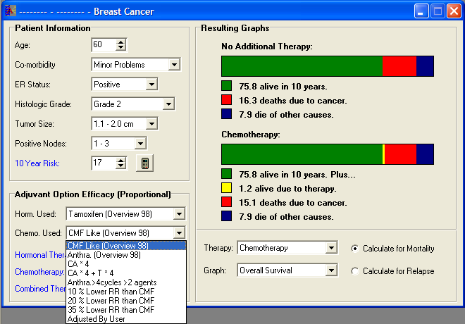
www/Adjuvantonline.com
do not take into account the individual biologic characteristics of the patient’s tumor.

Slide 9
Available guidelines that help for choosing proper adjuvant therapy for EBC
Adjuvant online
ESMO
NCCN Guidelines®
NICE
St Gallen Consensus
Oxford recommendation
ASCO® Guidelines
e
1 NCCN Practice Guidelines in Oncology. V.3.2013.
2 Harris L, et al. J Clin Oncol. 2007.
3 Goldhirsch A, et al. Ann Oncol. 2013.
4 NICE Diagnostics Guidance 2013.
ASCO is a trademark of the American Society of Clinical Oncology. NCCN and NCCN Guidelines are trademarks of the National Comprehensive Cancer Network. The guidelines do not endorse products or therapies.
*Intermediate risk of distant recurrence is defined as Nottingham Prognostic Index score above 3.4 or being at intermediate risk by other decision making tools or protocols

Slide 10
Risk Groups; Prognostic factors for EBC
Low Risk
Age : 35Y or more
Grade : I
L.N. : ZERO
ER/PR : +ve
Tsize : 2cm or less
[tumor 1cm or less]
High Risk
Grade : III
L.N. :4 and more
ER/PR : -ve/+ve
Vascular invasion
HER 2 Neu:+++/Fish
Intermediate Risk
Age : less 35
Grade : II-III
L.N. : 1-3
ER/PR :-ve/ +ve
T size (P) : >2cm

Slide 11
IS Chemotherapy in luminal BC mandatory??
In young as well as elderly patients?
Is It dependent on LN status and other factors
e.g T size ?
It’s role in large clinical trials is not clear as all included LN-ve cases (Intermediate and high risk).
Chemotherapy result in amenorrhea which may attribute to its real function in ER+ve pat.!!!
Notes:
And in question when we can avoid chemotherapy.. And can we build adjuvant tt on

Slide 12
Breast Cancer Genomic Signature Platforms
Oncotype DX®
MammaPrint®
Prosigna™
Hybridization with gene specific labels
RT-PCR gene expression
RNA gene microarray
Quantitative
(continuous)
Qualitative
(binary)
Quantitative
(Continuous)
Gene expression levels of relatively small number
of genes
Gene expression of large number of genes
Gene expression levels of relatively large numbers
of genes
High precision
Modest precision
Moderate to high precision
Notes:
Whether the classifier is based on DNA microarray analysis, hybridization with gene-specific labels or on RT-PCR analysis, it is important that the assay be standardized and that evaluations of reproducibility be conducted.

Slide 13
Tumor burden vs Biology
Q: chemotherapy for patients with higher disease burden?
Although tumor bulk per se is not included in the OncotypeDX RS (which was developed in patients with node-negative disease), Nevertheless, not all patients with node-positive disease have high RSs, and the SWOG 8814 study suggests that chemotherapy has little if anything to offer to those with low or intermediate RSs.
Thus, by this measure, it is tumor biology, not tumor bulk, that defines chemotherapy utility.
A. Goldhirsch, International Breast Cancer Study Group, European Institute of Oncology, 2012
Notes:
There is a long-established practice of recommending chemotherapy for patients with higher disease burden. Although tumor bulk per se is not included in the OncotypeDX RS (which was developed in patients with node-negative disease), higher RSs have on average been observed among patients with increasing tumor burden as evidenced by node involvement.^{26,40} Nevertheless, not all patients with node-positive disease have high RSs, and the SWOG 8814 study suggests that chemotherapy has little if anything to offer to those with low or intermediate RSs. Thus, by this measure, it is tumor biology, not tumor bulk, that defines chemotherapy utility.

Slide 14
Multi-gene Assay for Predicting Recurrence in Node Negative Breast Cancer Patients - NSABP B-14 Study.
40
Low
RS < 18
Rec. Rate = 6.8%
C.I. = 4.0% - 9.6%
Intermediate
RS 18 - 31
Rec. Rate = 14.3%
C.I. = 8.3% - 20.3%
High
RS ≥ 31
Rec. Rate = 30.5%
C.I. = 23.6% - 37.4%
35
30
?
25
Rate of Distant Recurrence at 10 years
20
15
Recurrence Rate
10
95% C.I.
5
0
0
5
10
15
20
25
30
35
40
45
50
Recurrence Score
Paik .S. et al. 26th annual San Antonio breast cancer symposium 2004.

Slide 15
TAILORx Trial
Trial Assigning IndividuaLized Options for Treatment
Node Negative
ER+ /PgR+
HER2 negative (IHC 0-1+ or FISH [-])
Oncotype DX™ Assay
RS > 25
Chemotherapy*
+
Hormonal Rx*
(Arm D)
(27%)
RS < 11
Hormonal
Therapy*
(Arm A)
(29%)
RS 11 - 25
Randomize
Hormonal Rx*
(Arm B)
vs.
Chemotherapy* + Hormonal Rx*
(Arm C)
(44%)

Slide 16
TAILORx seeks to incorporate a molecular profiling test into clinical decision making,
q: Can we spare women unnecessary treatment if chemotherapy is not likely to be of benefit. ??
TAILORx is one of the first trials to examine a methodology for personalizing cancer treatment

Slide 17

The TAILORx trial enrolled 10,273 women with HR+ve & HER2-negative, LN –ve
6,711 had R S (11 - 25) and were randomly assigned to receive hormone therapy alone or hormone therapy and chemotherapy.
At a median follow-up of 9 years, indicating that hormone therapy alone was not less effective than chemotherapy plus hormone therapy in women with a Breast Recurrence Score of 11 to 25. as regard DFS, dist met, and OS(83.3% vs 84.3%), (94.5% vs 95.0%), (93.9% vs 93.8%),
Another important finding was the identification of the group that did have some chemotherapy benefit ((women 50 years or younger who had a Breast Recurrence Score of between 16 and 25.))

Slide 18
chemotherapy may be spared in:
All women older than 50 ys with hormone receptor–positive, HER2-negative, node-negative breast cancer and a Recurrence Score of 0 to 25
All women 50 ys or younger with hormone receptor–positive, HER2-negative, node-negative breast cancer and a Recurrence Score of 0 to 15
Grey zone in premenopausal 15-25 ???

Slide 19
High risk premenopausal luminal A breast cancer patients derive no benefit from adjuvant chemotherapy: Results from DBCG77B randomized trial, Nielsen TO, SABCS2015 [S1-08]
Premenopausal women whose invasive breast cancers were of the luminal A subtype had comparable 10-year disease-free survival rates regardless of whether or not they received adjuvant chemotherapy, according to data from :
Phase IIIDBC G778 Clinical trial
phase III DBCG77B clinical trial, Torsten Nielsen, the University of British Columbia in Vancouver, Canada. 2015 SABCS
Notes:
We wanted to address the clinical question of whether or not women with molecularly low-risk luminal A breast cancer actually benefit from chemotherapy,” added Nielsen. “Instead of starting a new trial and waiting for 10 years to find answers, we used an older, completed trial that had saved tissue samples for future studies.”

Slide 20
Between 1977 and 1983, 1,146 premenopausal women who had lymph node-positive breast cancer that was larger than 5 cm were randomized to two chemotherapy arms and two no- chemotherapy arms in the Danish Breast Cancer Cooperative Group 77B trial. All women received radiotherapy.

Slide 21
10 y DFS ((DBCG77B)) and overall survival (OS) between benefit of chemotherapy and subtype (luminal A vs non-luminal A).
In total, 709 patients had tissue available and completed IHC intrinsic subtyping.
IHC classified 165 as luminal A, 319 luminal B, 58 HER2E and 91 TN
Patients with luminal A did not benefit from chemotherapy (HR = 1.07, p = 0.86),
whereas patients with non-luminal A subtypes did benefit (HR = 0.50, p < 0.001).

Slide 22
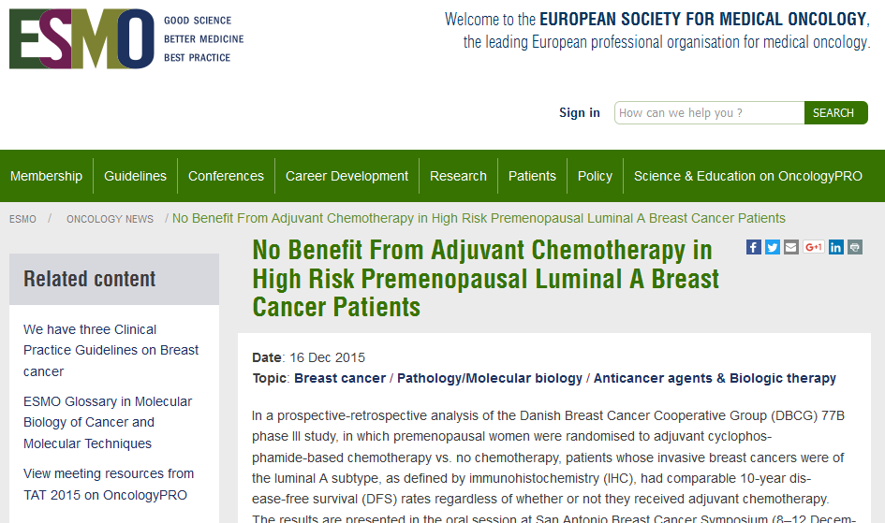

Slide 23


MINDACT study design
6000 patients, <70 YRS, 1-3 POS NODES
ASSESS Clinical RISK AND MammaPrint RISK
(adjuvant!online & MammaPrint)
BOTH HIGH RISK
DISCORDANT
RISK
BOTH LOW RISK
RANDOMIZE
decision-making
Use clinical risk
Use MammaPrint
high
low
high
low
Chemotherapy
No chemotherapy

Slide 24
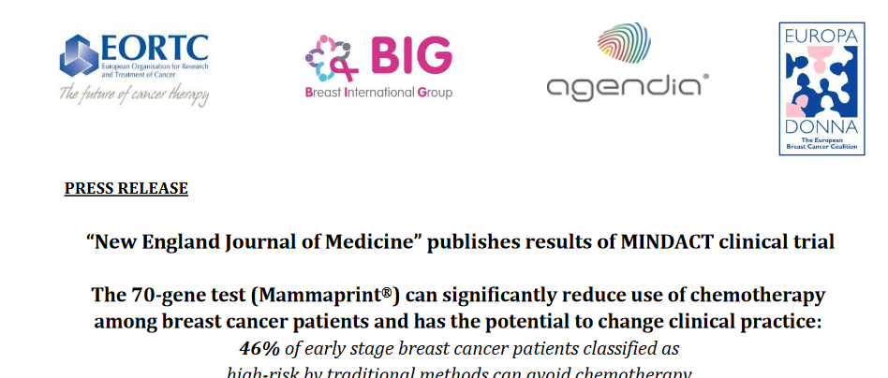
46% of patients who were at high clinical risk for recurrence, defined using Adjuvant! Online, might not require chemotherapy. These women had a low genomic risk for recurrence according to the 70-gene signature test.

Slide 25
ESMO 2017: MINDACT Study in Early-Stage Breast Cancer Shows Even Small Tumors Can Be Aggressive
Key Points
The subanalysis included the 826 patients with a primary tumor size of less than 1 cm (pT1ab, pN0).
Clinical and genomic risks were assessed, and 196 patients (24%) were found to be at clinical low risk and genomic high risk. These patients were randomized to receive or not receive chemotherapy.
The researchers found that at 5 years, very few patients who received chemotherapy experienced disease relapses and showed high rates of distant metastasis–free survival, disease-free survival, and overall survival, which confirms that they derived benefit from chemotherapy.

Slide 26
ESMO 2017: MINDACT Study in Early-Stage Breast Cancer Shows Even Small Tumors Can Be Aggressive
“This study shows that it’s not only tumor size that is important for breast cancer patients, but also tumor biology. All tumors in the study were small—less than 1 cm—and the lymph nodes were free of cancer (node-negative), which in principle should be a signal of good prognosis. But nearly one in four patients—those identified as genomic high-risk—derived benefit from chemotherapy.”
“Small node-negative tumors can be very aggressive, even if they are classified as clinical low risk.
Tumor biology needs to be taken into account when deciding adjuvant treatments in this patient population. One cannot forget the patient’s age, performance status, comorbidities, and preferences during the discussion.”
ESMO 2017 Fatima Cardoso, Co-Principal Investigator of MINDACT, and Director of the Breast Unit Lisboan University

Slide 27
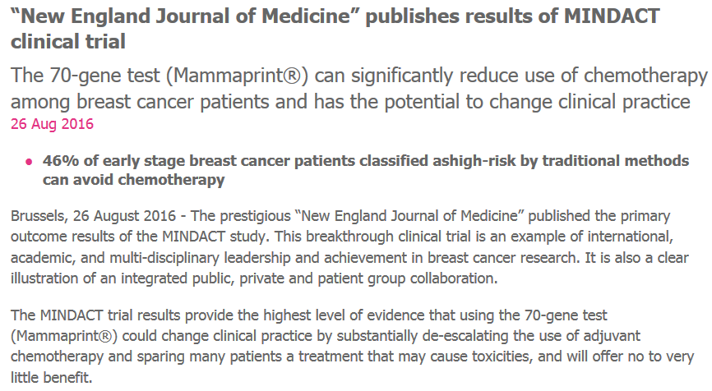
The MINDACT trial results provide the highest level of evidence that using the 70-gene test (Mammaprint®) could change clinical practice by substantially
de-escalating the use of adjuvant chemotherapy and sparing many patients a treatment that may cause toxicities, and will offer no to very little benefit.

Slide 28
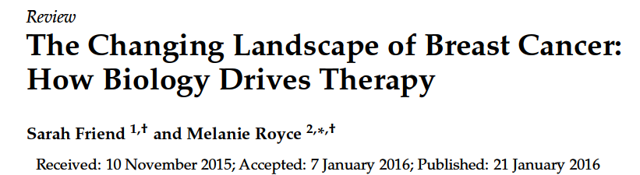
Medicines 2016, 3, 2; doi:10.3390/medicines3010002

Slide 29
Neoadjuvant: Is It Related to Biology?
Luminal A - B ?
Hormonal Neo/adjuvant ?
postmenopausal / premenopausal
HER2Neu positive
TNBC ?
PCR

Slide 30
Pathological Complete Response and Breast Cancer Subtype
Tumor Subtype | Percentage of type of breast cancer | Complete pathological response
ER/PR pos, her2 neg | 40-55% | 8%
ER/PR pos, her 2 pos “Triple positive” | 15-20% | 19%
ER/PR neg, her 2 pos | 7-12% | 39%
Triple Negative | 13-25% | 31%
Houssami 2012 EJC

Slide 31


Neoadjuvant Therapy and the choices according to biology
(pCR) is a valid surrogate of long-term survival and cure from breast cancer
Information on the outcome associated with pCR to neoadjuvant therapy may allow switching from an ineffective regimen to a more effective one.
pCR in luminal BC after chemotherapy 2% to 10% , suggesting that other lines of therapy must be consider.

Slide 32
Neoadjuvant Therapy and the choices according to biology
Neoadjuvant endocrine therapy should be considered in place of neoadjuvant chemo. for postmen. BC Luminal A type.
should be continued for a minimum of 4–8 months.
Selected patients with special types of breast cancer (e.g. pure tubular, cribriform and mucinous tumors) have a limited expected benefit from Neoadjuvant and will receive adjuvant endocrine therapy alone.

Slide 33
Guidelines according to evidence based recommendation
All luminal cancers should be treated with ET. Most luminal
A tumours, except those with highest risk of relapse (extensive nodal involvement), require no chemotherapy [II, A]
luminal B HER2-negative cancers constitute a population of the highest uncertainty regarding chemotherapy indications [I, C].
Indications for chemotherapy within this subtype depend on
the individual risk of relapse, taking into account the tumour
extent and features suggestive of its aggressiveness (grade,
proliferation, vascular invasion), presumed responsiveness to
ET and patient preferences.
EBC;ESMO guidelines; Annals of Oncology24,supplement 6,vol7,2013

Slide 34
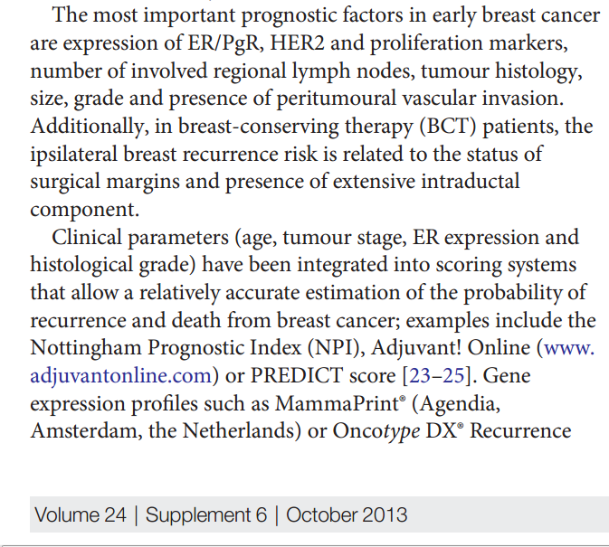
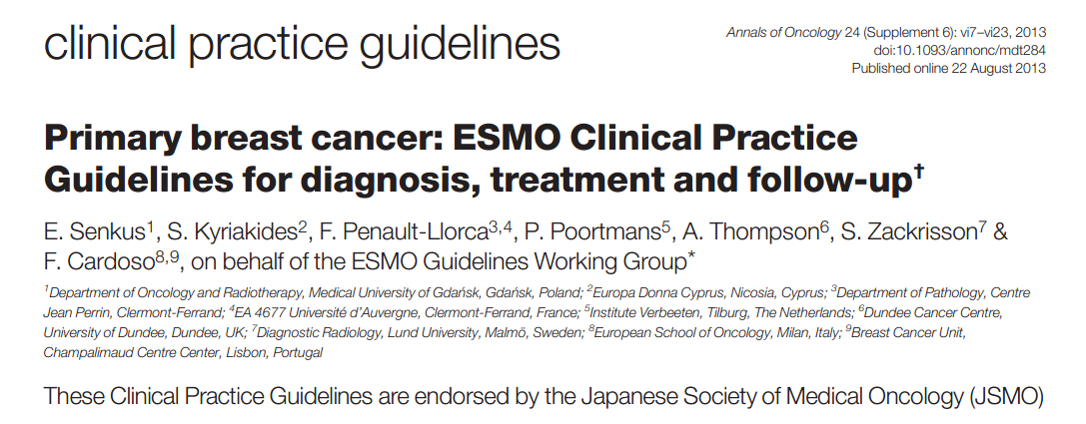
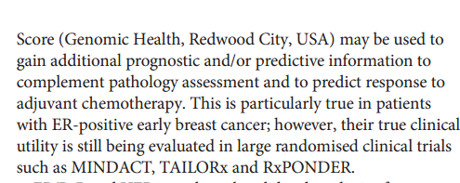


Slide 35
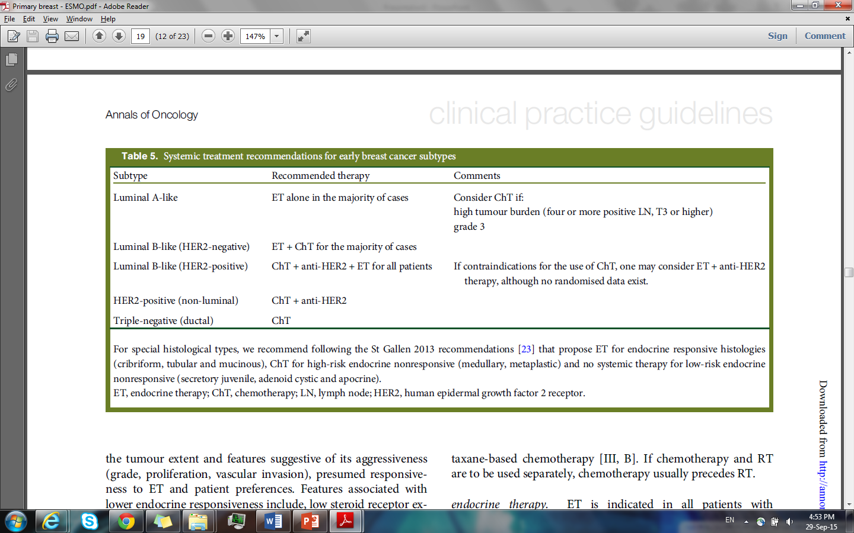

Slide 36
For sure the grey zone in Adjuvant /Neoadjuvant becomes narrower than before
More defining of biomarker may help us to take a more beneficial clear decision to EBC patients

Slide 37

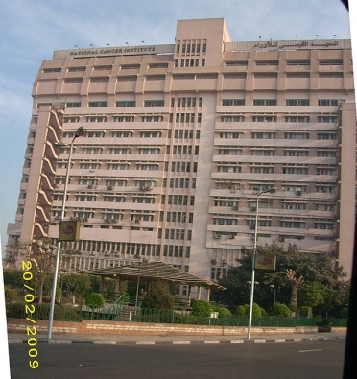
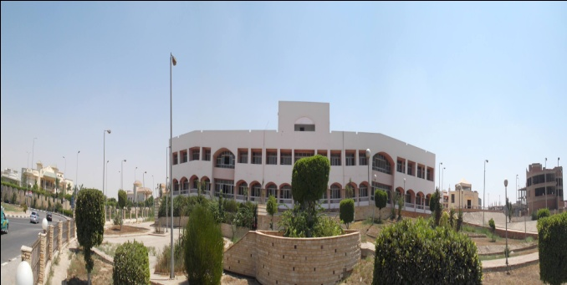
THANK YOU
NCI, Breast Cancer Treatment and Research Center
NCI Main Center

